Slide 1


Cross-platform Mobile Development (with C#)
Xamarin and MvvmCross

Slide 2
The Future Is Mobile!
Facebook posts
Emails
Tweets
60 %
75 %
90 %
Bill Boorman, ATC 2012

Slide 3
Agenda
Introduction 10’ olb
Challenges in mobile development
Code-sharing using Xamarin and MvvmCross
Building the “Zühlke X-Platform Messenger” 40’ ssh/urb
Questions (concerning the app)
myBosch App: Experiences 5’ kwl
Zühlke as Xamarin’s Premium Consulting Partner 5’ kls
Discussion 20’
Wrap-up 5’ olb

Slide 4
Web, Hybrid or Native?
jQuery Mobile
PhoneGap
Xamarin
Criteria | Web | hybrid | native
User Experience |  |  | 
Performance |  |  | 
Offline capability |  |  | 
Hardware |  |  | 
Payment models |  |  | 
Multi-platform |  |  | 
Abstraction |  |  | 
Deployment |  |  | 

Slide 5
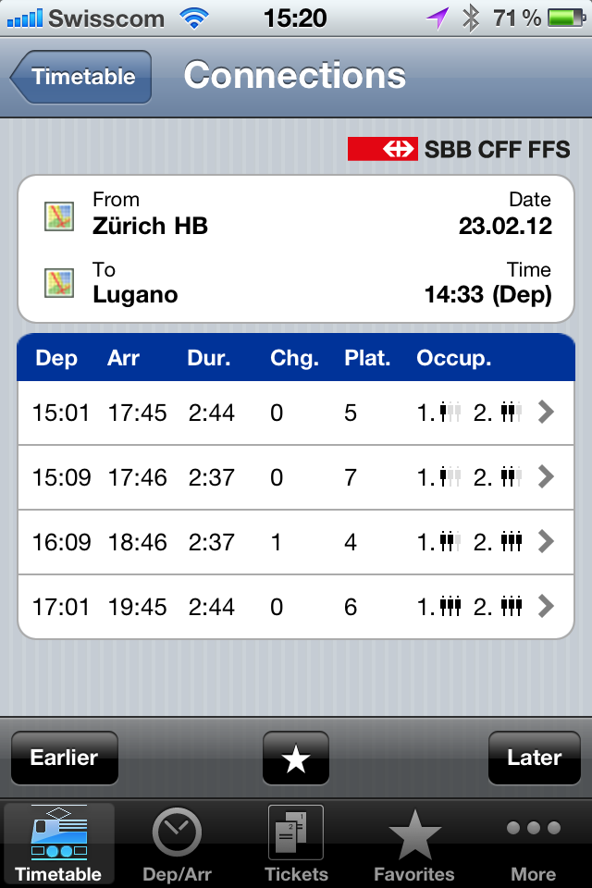
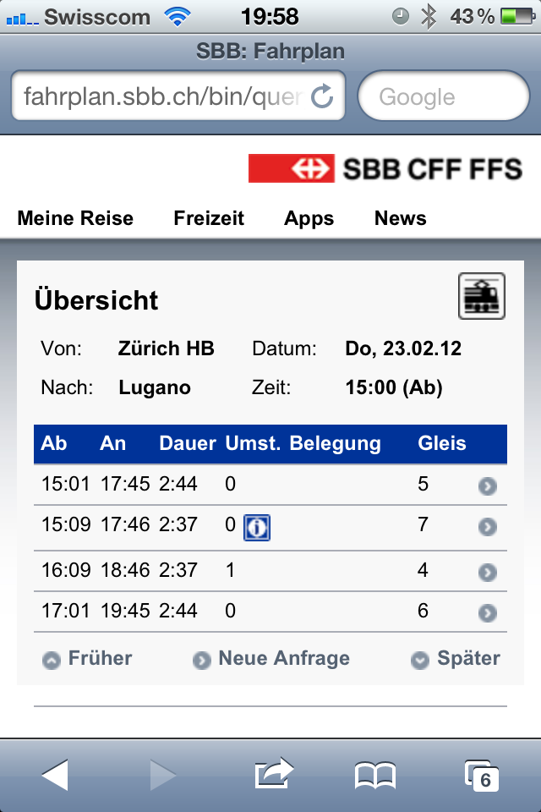
Example: Native vs. Web
Native
Web
Interaction elements
Deployment, updates
Offline capability (Buy ticket)
Hardware (Shake for most current ticket)
64 %
36 %
Mobile phone time
Nielsen, 2012

Slide 6



Code Sharing Using Xamarin and MvvmCross
Xamarin
MvvmCross
User interface
User interface
View
View
ViewModel
ViewModel
ViewModel
Model
Model
Model
Business layer
Business layer
Business layer
Service (Azure)
HTTP
HTTP

Slide 7

Initial Position
.NET development team (C#)
Customer database
Cloud service (Azure) providing a RESTful API
Business layer (.NET) for using services as Portable Class Library (PCL)
Zühlke Messenger
Service (Azure)
?
Business layer (.NET)
HTTP

Slide 8

Tooling Android
1
Visual Studio
Project Types
Android simulator

Slide 9

Tooling iOS
2
Xamarin Studio
C# example
iOS simulator (remote)

Slide 10
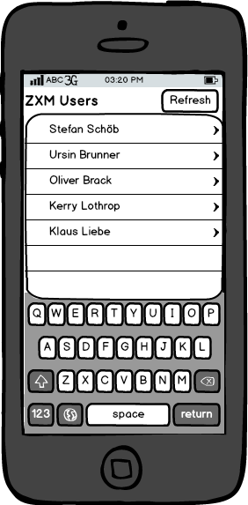
User Interface Mockup
Requirements
User list
Refresh button
Vision
User details
Messages

Slide 11
MvvmCross Setup with NuGet
3
Prepared Solution
NuGet → Install MvvmCross
Run mini-Demo

Slide 12
Shared Model/ViewModel (1/2)
4
Benutzer Class
ViewModel → Dummy Daten
View → DataBinding

Slide 13
Shared Model/ViewModel (2/2)
5
Create UserList-View (XML)
DataBinding
UserList Service
Request users from web
RestSharp and Json.NET

Slide 14
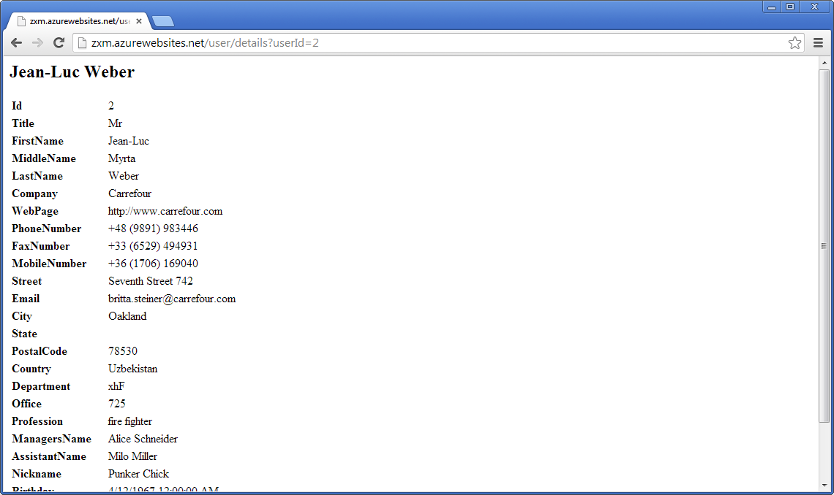
User Details

Slide 15
Including HTML5 Content
6
Navigation shared
WebView (existing)

Slide 16
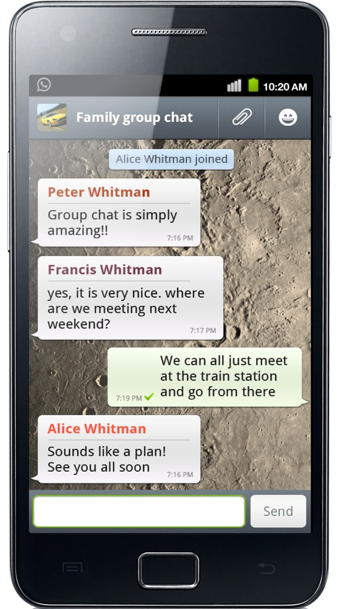
Messages
Requirements
Group chat
Every user can post messages
All users see whole message history

Slide 17
Messages
7
MessageList
MessageService
MessageViewModel
MessageView
AddMessageView
AddMessageViewModel
Send message using MessageService

Slide 18

What About Security?
What about testing?
How can we ensure proper encryption/decryption?

Slide 19
Client-side Encryption
8
EncryptionService
Include BountyCastle
TDD
MessageEncryptionService

Slide 20
Data in the Cloud
Azure
Encryption demo
Hardcoded password/username?

Slide 21
SQLite with LINQ
9
SQLite plug-in (plug-in system)
Username/password
LINQ

Slide 22

Questions (concerning the App)

Slide 23
myBosch App: Experiences
Kerry Lothrop

Slide 24
Zühlke as Xamarin’s Premium Consulting Partner
Klaus Liebe

Slide 25
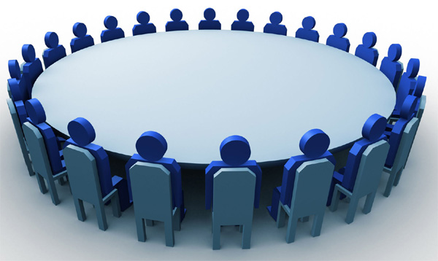
Discussion

Slide 26



About us
Ursin Brunner
Software Engineer
SWE-PRO/JAP
Stefan Schöb
Software Engineer
SWE-EPS/ESI
Klaus, Kerry, etc.?
Oliver Brack
Nearshoring Manager
Zühlke Serbia

